Slide 1


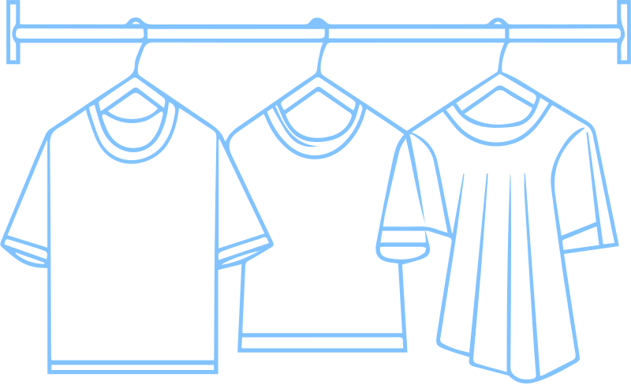
GARMENT EMPLOYEE
PRODUCTIVITY PREDICTION
PROJECT PROPOSAL

Slide 2


Business Problem
Garment manufacturing facilities face significant challenges in accurately forecasting daily worker productivity due to complex variables such as overtime, team sizes, and production delays. Relying on traditional estimations creates a gap between target and actual output. This directly leads to inefficient resource allocation and missed delivery deadlines, resulting in financial losses and damaged client trust.
This project aims to build a model that predicts actual daily productivity in advance, enabling management to optimize resource allocation and hit delivery targets reliably.

Slide 3



Project Objectives
  Analyze the dataset to identify factors associated with and affecting productivity.
  Build a machine learning model that can predict actual productivity.

Slide 4

DATASET OVERVIEW
1,197 14 Regression
Records Features Problem Type
Source: UCI Machine Learning Repository
Target: actual_productivity

Slide 5
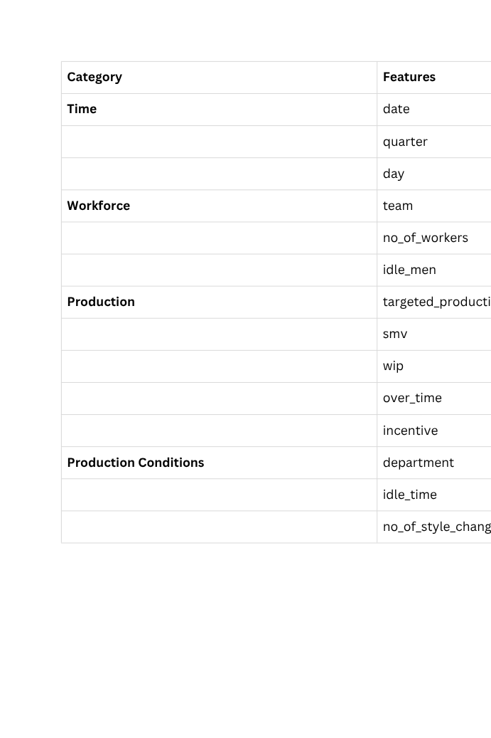
DATASET OVERVIEW
Features

Slide 6

Next Step:
Explore the dataset deeper and investigate the factors affecting productivity.

